Slide 1
Java collections
Examples

Slide 2
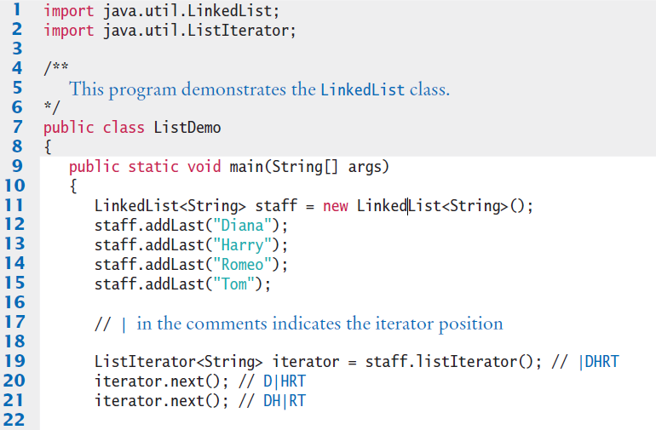
ListDemo.java (1)
Illustrates adding, removing and printing a list

Slide 3
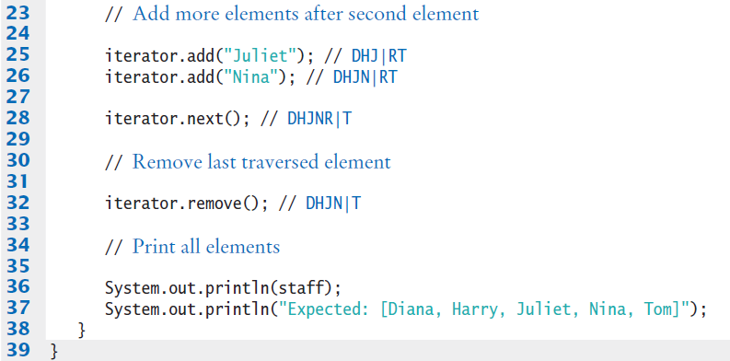

ListDemo.java (2)

Slide 4
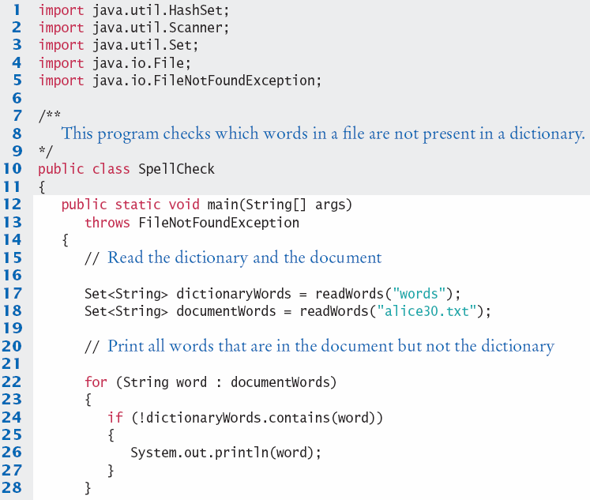
SpellCheck.java (1)

Slide 5
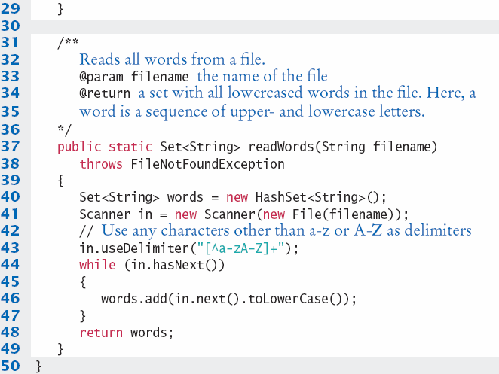
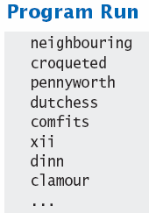
SpellCheck.java (2)

Slide 6
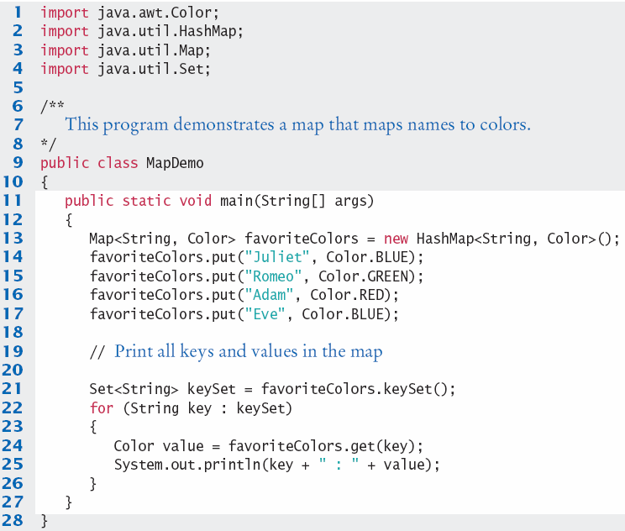
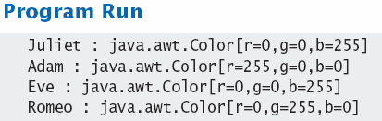
MapDemo.java

